Slide 1
Virtualizer Studio: TLM Creation
Quickstart Training - Model Integration in Virtual Prototype Design
© 2024 Synopsys, Inc. All Rights Reserved
Notes:
Welcome to the module 6 of the TLMC QuickStart training - Model Integration in Virtual Prototype Design!

Slide 2
CONFIDENTIAL INFORMATION
The information contained in this presentation is the confidential and proprietary information of Synopsys. You are not permitted to disseminate or use any of
the information provided to you in this presentation outside of Synopsys without prior written authorization.
IMPORTANT NOTICE
In the event information in this presentation reflects Synopsys’ future plans, such plans are as of the date of this presentation and are subject to change. Synopsys is not obligated to update this presentation or develop the products with the features and functionality discussed in this presentation. Additionally, Synopsys’ services and products may only be offered and purchased pursuant to an authorized quote and purchase order or a mutually agreed upon written contract with Synopsys.

Slide 3
Agenda
Introduction
  Virtualizer Studio Overview + TLM Creation Flow
Part 1: Model Skeleton Creation
  Model interfaces, memories, registers, build settings, IP-XACT import, etc.
Part 2: Test Driven Design Methodology
  Unit testing framework, test utilities, functional coverage, etc.
Part 3: Model Behavior Implementation
  Default and custom callbacks, continuous assignments, etc.
Part 4: Model Debugging
  SystemC debugging, using FastTrack messages, source code debugging, etc.
Part 5: Import of Existing SystemC Models
Part 6: Model Integration in Virtual Prototype Design
Notes:
Look into the overview to get an insight into the training contents.

Slide 4

Objectives
After completing this module, you should be able to:
Integrate and use a Model Generated by TLM Creator in a VDK
  In a VDK design in the VDK Creation perspective of Virtualizer Studio
  By exporting the model to be used in other platform creation tools

Slide 5
Using the Model in a Virtual Prototype
  Export overview
  Using the Model in Virtualizer Studio – VDK Creation perspective
Notes:
This section includes the steps, for instantiating the generated TLM Model in a Virtual Prototype, using the VDK Creation perspective of Virtualizer studio.

Slide 6
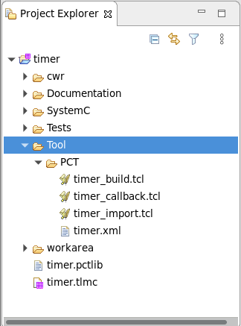
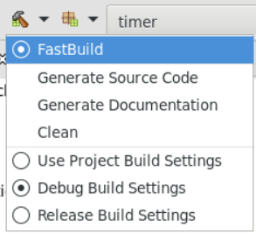
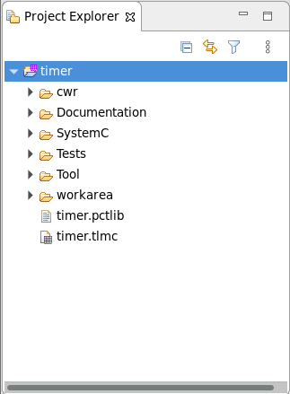
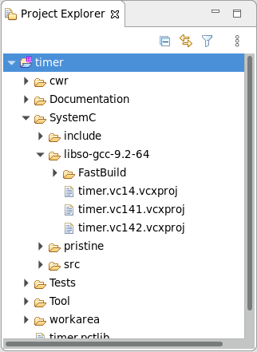
Build and Export for Use in Platform Tool
timer_import_user_pre.tcl
timer_import_user_post.tcl
Customization of the Component Model Library is possible using the Pre- and Post- Tcl scripts
Model Build Output for the FastBuild Configuration and gcc-9.2-64 Compiler version
Script used to create component model library
Component Model Library
Notes:
Whenever a model is built in Virtualizer studio, the code for the model gets compiled into a library created in a directory, named with the selected build configuration and compiler settings in the generated output. This is done to ensure that multiple compiler and build settings combinations, can be built and saved, for the same model project.
PCT and other tools compliant files are also created in the Tools folder. The Component model library file, which gets created every time the model is built, can be used by the authoring tools to use the model, when assembling a platform.
You can customize the generated library, with the help of the Pre- and Post-import Tcl scripts.

Slide 7
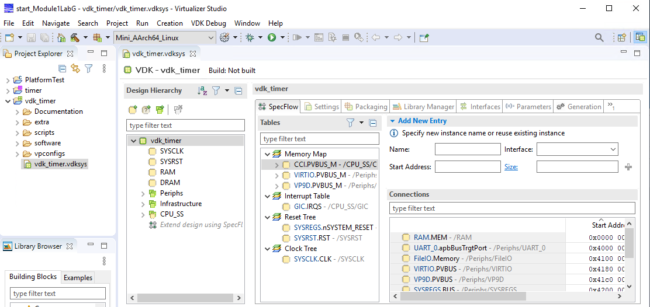
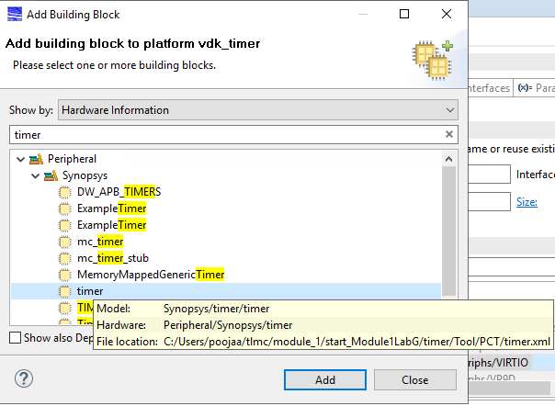
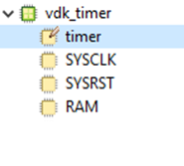
Use in Virtualizer Studio – VDK Creation
Click to Add building block to the VDK
The timer model is added to the VDK
Select the timer model and click Add.
Double-click to open your VDK Project for editing
Notes:
In case you start a VDK Creation project in Virtualizer studio in the same workspace as your TLM Model project, the model is automatically detected, and is available for use in the VDK Creation perspective.
Double-click on the VDK Creation Project file in the Project Explorer, to open your VDK project.
For adding the component to your VDK, click Extend VDK in the Design Hierarchy tab to select an extension point, and look for the model to be added in the Extend VDK tab. If not shown, try to search for the model using filters. If the model is compatible to the extension point, it will show up in the search.
Then, you can add it to the VDK project by a simple drag-and-drop. Once added, you can easily configure, and connect the model in your VDK as per your design requirements.

Slide 8
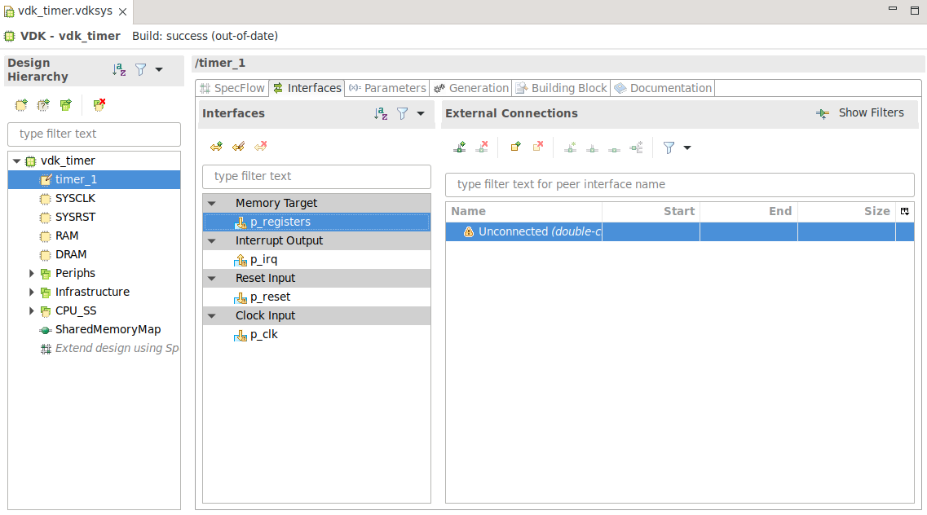
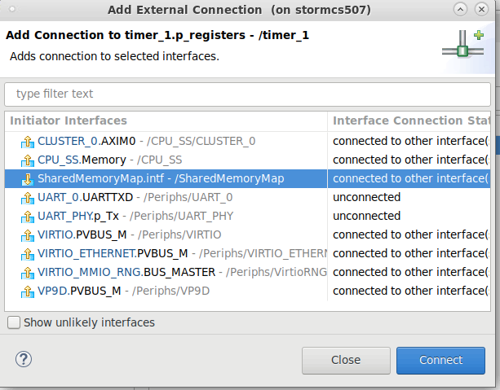
Use in Virtualizer Studio – VDK Creation
Focus on the Interfaces tab
Double click
Select the SharedMemoryMap

Slide 9
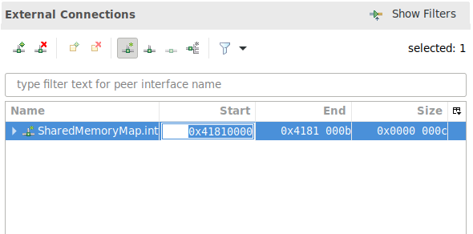
Use in Virtualizer Studio – VDK Creation
Set Start to 0x4181000

Slide 10
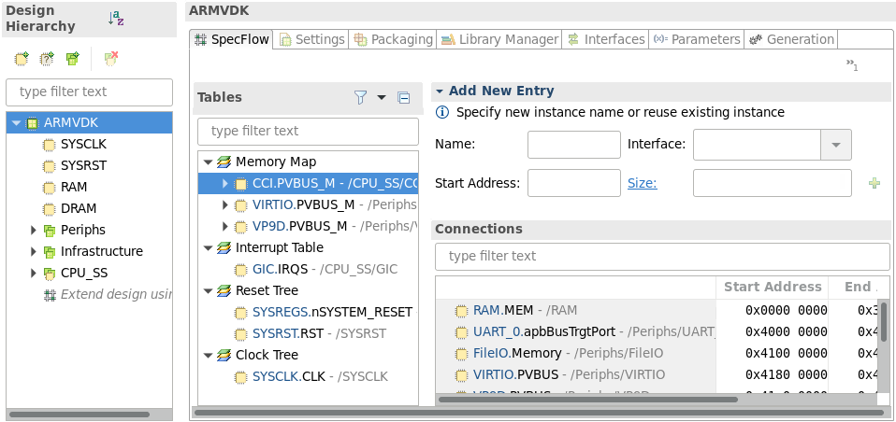
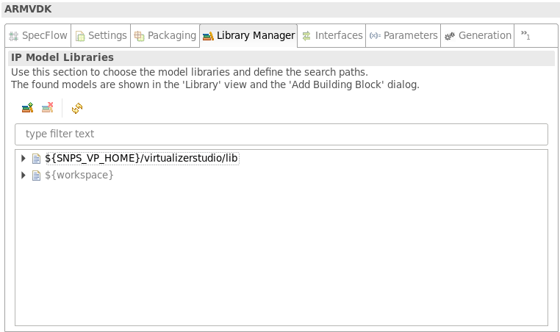
Use in Virtualizer Studio – Library Manager
Library Manager tab
Click to open
Select the top-level VDK project entry
In case the TLM model library is not saved in the same workspace as the VDK project, you will need to add the model library to the accessible list from the Library Manager tab of the VDK Editor. Lets see how!
Click Add Model Library
Specify the library path in the newly added row
The model can now be accessed in the VDK project
Notes:
In case the TLM model library is not saved in the same workspace as the VDK project, you will need to add the model library to the library manager of VDK Creator.
Select the top-level VDK project entry in the design hierarchy, and click to open the library manger view. Click the Add New Search Path Button, for managing IP Model Libraries for your VDK project. Enter the path to the model library or Use a File Browsing button to specify the search path to be added.
Now, use the Extend VDK view, to add the component to your VDK.

Slide 11
Hands On Labs on this topic
Module 1 Lab G: Model Usage in a VDK
You can integrate models developed or imported in TLM Creator easily into your virtual prototype design using the VDK Creation perspective of Virtualizer Studio
Your task for the current exercise to go through the steps to add the timer model (created in the earlier labs) in a VDK project in Virtualizer Studio
Notes:
Accompanied Lab Modules Overview!

Slide 12

Thank You

